Slide 1
Leetcode Workshop
Session 3 - Dynamic Programming

Slide 2
Agenda
What is Dynamic Programming
Identifying DP Problems
Case study: Fibonacci Sequences
Practice - Unique Paths
Challenge - Unique Paths II
Extension - Coin Change

Slide 3
What is DP?

Slide 4
“Those who cannot remember the past are destined to repeat it”

Slide 5
Dynamic Programming
Algorithmic technique that is used to solve a problem by breaking it down into simpler sub-problems
Solution to overall problem depends on the optimal solution to the sub-problems.
Patterns (In Theory)
Overlapping Subproblems - Repeated brute force computation
Optimal Substructure - Sub-problems build to overall solution

Slide 6
Dynamic Programming
2 general kinds of Dynamic Programming:
Top-down (Memoization)
Bottom-up (Tabulation), Today’s focus
In general, DP Problems Focus on
Figuring out recurrence relation (How subproblems build answer)
Building base cases that the DP can build on

Slide 7
Fibonacci Sequence
Code demo for DP

Slide 8
Practice
Unique Paths - https://leetcode.com/problems/unique-paths/

Slide 9
Hints
Think about the restrictions. What actions are the robot permitted?
Remember that in DP,
Build base cases first
Then build upon those base cases
What is the sum of unique paths to a non-top/left border square?

Slide 10
Intuition
Remember that the Robot can ONLY move right and down. That’s very handy for formulating restrictions!
There is only 1 unique path to the right and below
The unique path to a square is the sum of the unique paths to the top and left square

Slide 11
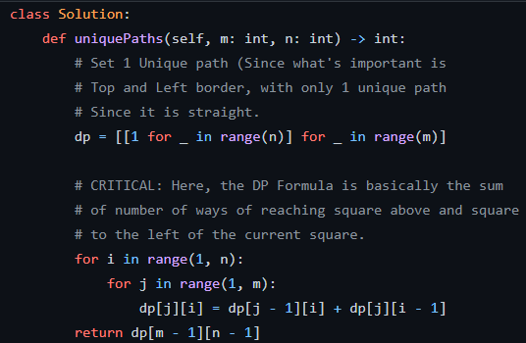
Solution

Slide 12
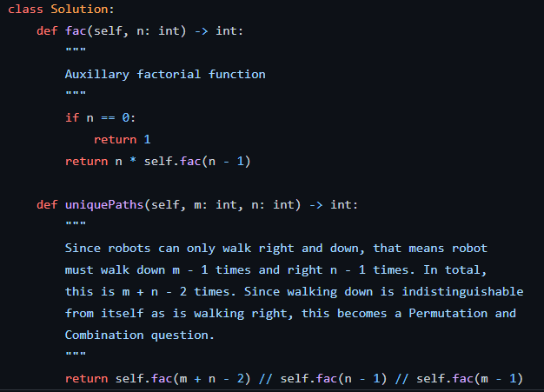
Solution - Alt

Slide 13
Further Practice
Unique Paths II - https://leetcode.com/problems/unique-paths-ii/

Slide 14
Hints
Question is very similar to the previous. However, the stone becomes a concession
How does the stone affect
The base case
The DP Step
After that, it’s up to you to code it.

Slide 15
Intuition
For vertical and horizontal paths, if stone is placed, any square beyond the stone is not reachable.
If stone, mark as unreachable
Else, reachability of square depends on previous
For the DP Step, if stone is placed, then that square is not reachable
The rest is just to code these modifications.

Slide 16
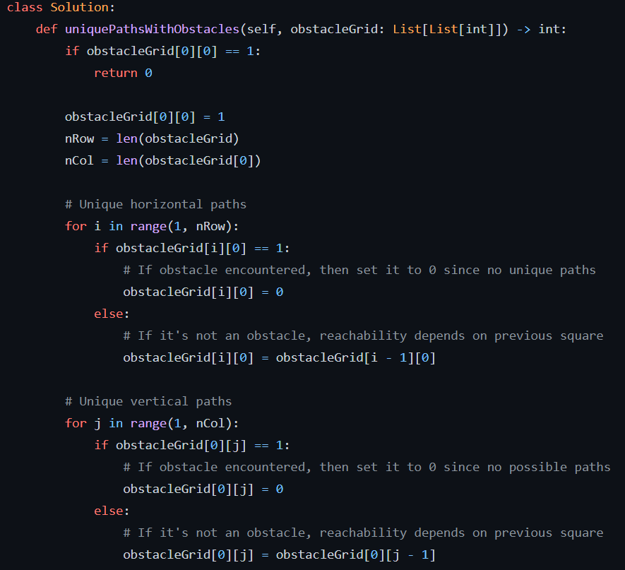
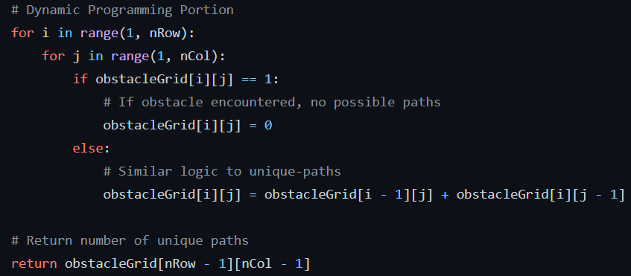
Solution

Slide 17
Last Practice
Coin change - https://leetcode.com/problems/remove-duplicates-from-sorted-array/

Slide 18
Hints
What is a base case of coin change that holds for all types of coin?
Remember that the coins are not sorted!
How would the recurrence relation (Subproblem) build up?
How could you check whether amount is feasible or not?

Slide 19
Intuition
If amount is 0, then of course, there are 0 permutations of coins that can produce an amount of 0.
Sort coins to enable DP Recurrence relation
Recurrence links current amount to (amount - coin) value
You could initialize DP to unreachable value (<0, >amount) to check whether -1 should be answer

Slide 20
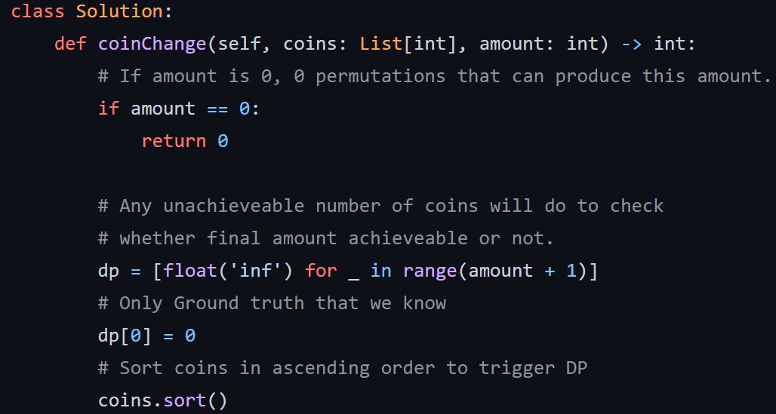
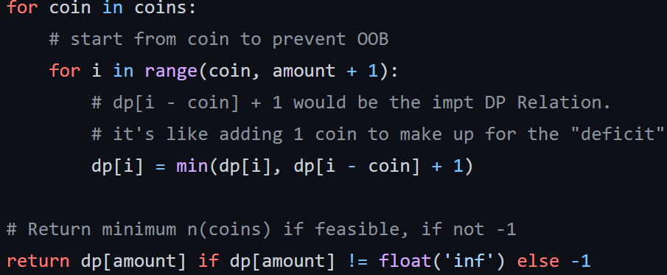
Solution

Slide 21
Thank you!
See you next week.

